Slide 1


FAA Wildlife Strike Database Insights
Valérie Dier, P.Eng

Slide 2
Paint a Picture with Data
Who will this inform?
Commercially-Driven Dashboard informs business teams
Visualizations help
Identify trends
No BI without actions
May need to redirect some investigations and analyses
Additional data may be required
Insights drive business decisions and risk mitigation
Spot outliers
Ask the right follow-up questions
Regulatory-Minded Dashboard informs environmental compliance teams

Slide 3

Commercially-Driven Dashboard

Slide 4
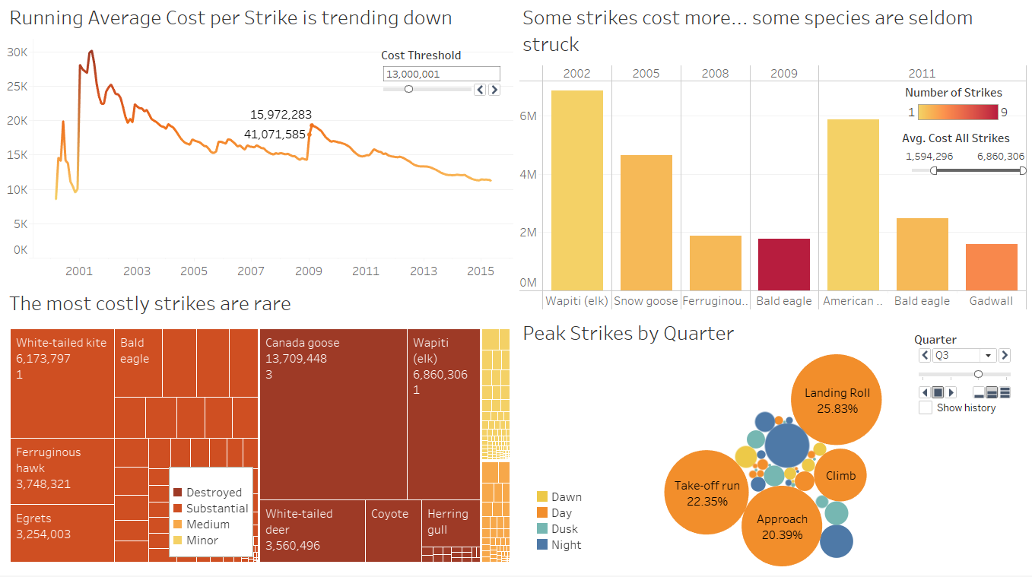

Slide 5
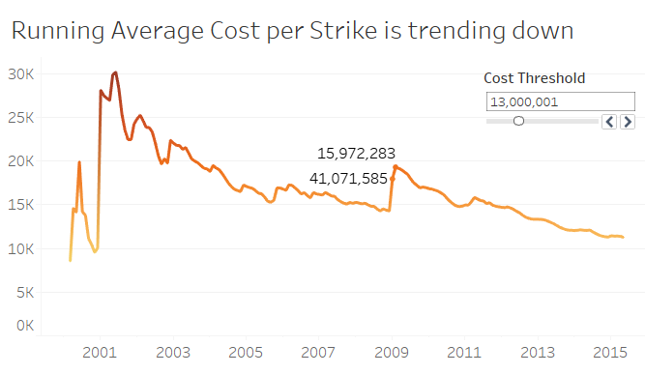
Running Average Cost
Downward trend
Reporting increased
Mitigating measures may be paying dividends
One-time high-consequence events cause spikes:
Emergency landing of US Airways flight 1549 on the Hudson river in January 2009

Slide 6
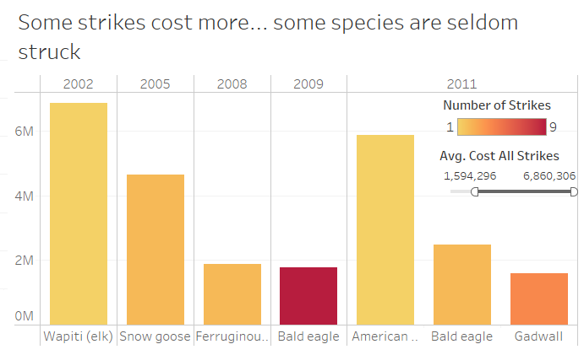
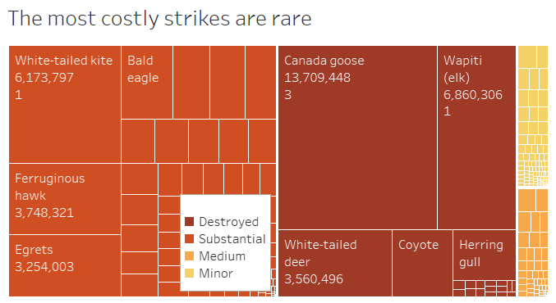
Cost by Species
Larger species like elk, geese, hawks or eagles may be struck less often but cause more damage per strike.
Smaller species may cause more damage in larger groups (i.e. flocks).

Slide 7
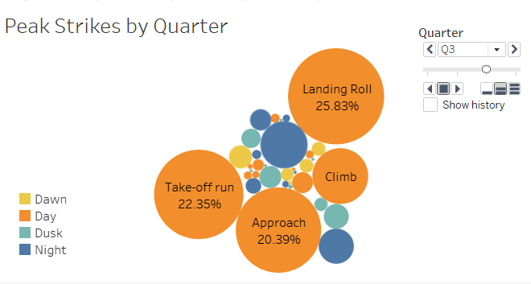
Strike Timing
Strikes mostly occur:
during the daytime
take-off, approach and landing
One notable exception:
Nighttime approach in Q4 accounted for 17% of strikes. This is consistent with reduced winter daylight hours in northern locales.

Slide 8

Environmentally-Driven Dashboard

Slide 9
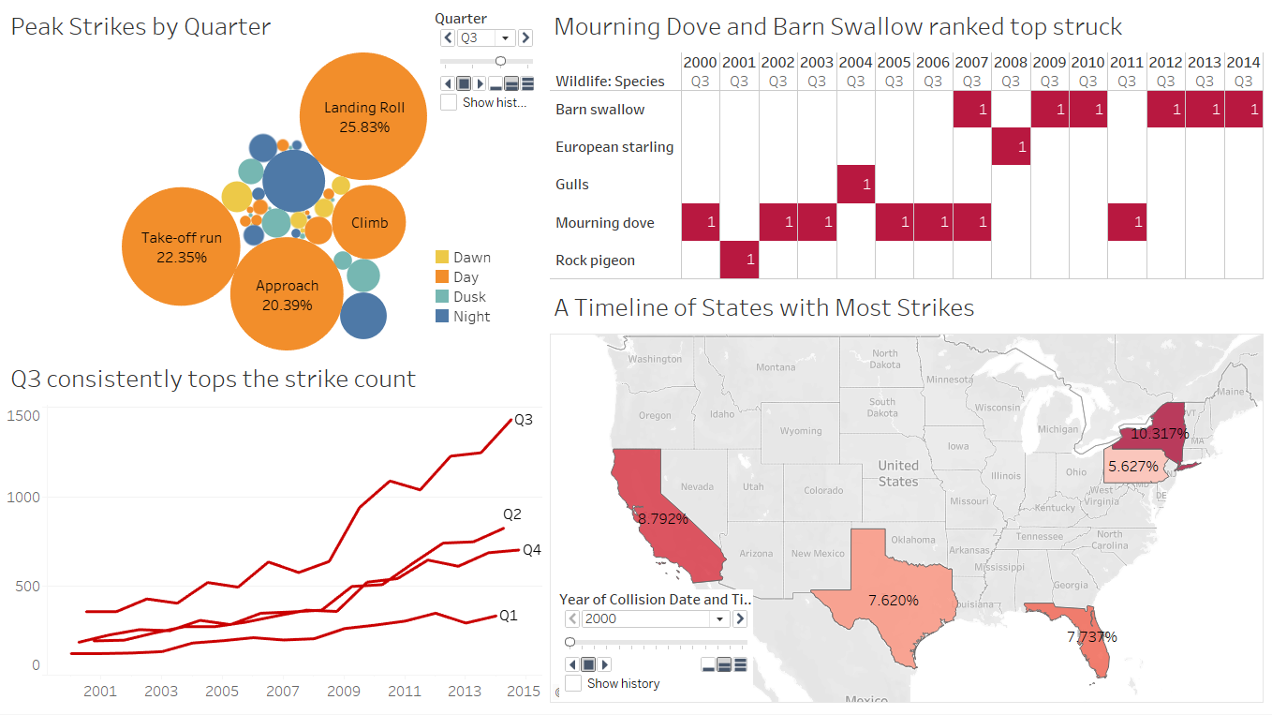

Slide 10
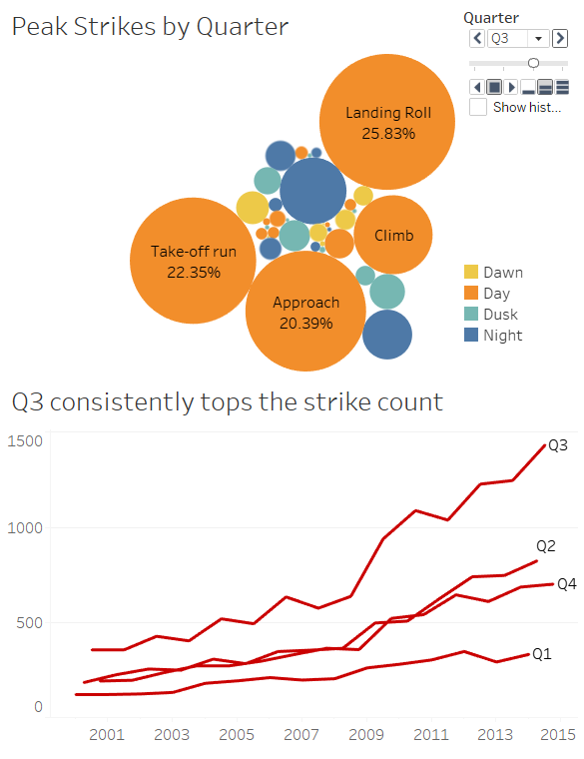
Strike Timing
Most strikes happen in daytime, usually during take-off, approach or landing
Some exceptions in Q1 and Q3 on nighttime approach
Q3 consistently tops the quarterly strike totals in a year

Slide 11
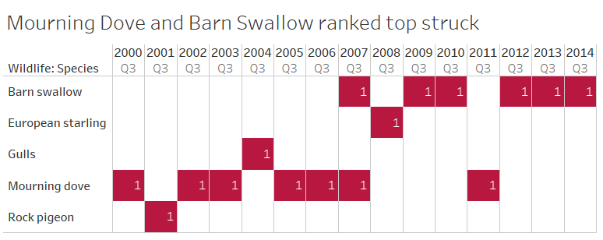
Which Species?
The Mourning dove or Barn Swallow have the highest quarterly strikes each year
The trend changed from Mourning dove to Barn Swallow around 2007
Could there be migratory behaviour changes?

Slide 12
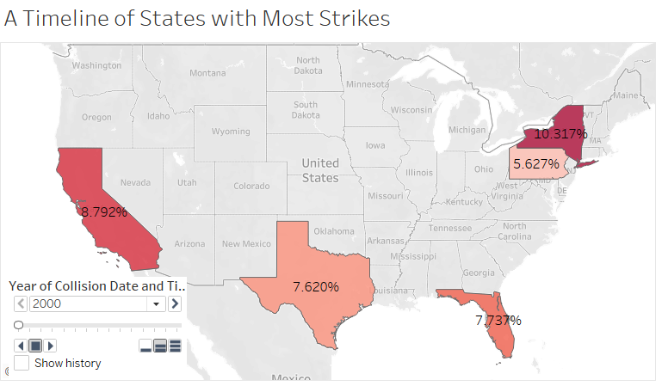
Hotspots
Strikes mostly occur in the same four states
California
New York
Texas
Florida
The fifth state shifts from New England region to further interior

Slide 13

Next Steps
Destination State data
Commercial and environmental efforts are correctly directed when locales reflect where strikes occur
Let’s Get Granular
Are highly-struck species driving costs or are low-count high-consequence strikes the big drivers?
What/When/Where
Environmental Compliance could probe whether Q3 high-strike species are in the same locales year over year

Slide 14

Dashboards tell a story…
Often open-ended as more investigation and different perspectives will drive new insights
It must target an audience, or may appeal to no one
An intersection may appear between groups with differing, though not opposing goals

